Slide 1

WAY TO ENTERPRISE
Pakage 1: Database

Slide 2
WAY TO ENTERPRISE
Lesson 5

Slide 3
Agenda
Subquery
View
CTE
Assignments
Copyright © VTI Academy All Rights Reserved

Slide 4
Subquery
Return a table
Return a value

Slide 5
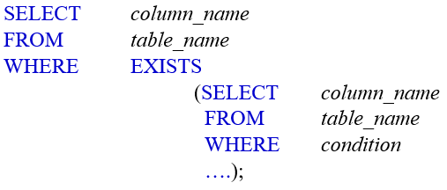
Syntax

Slide 6
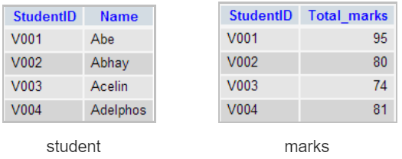



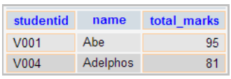
Example
Find students with mark greater than those with id = ‘V002'

Slide 7
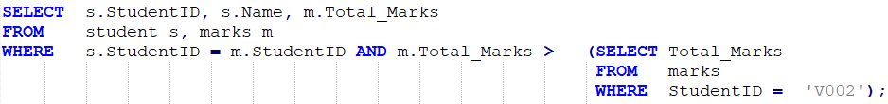
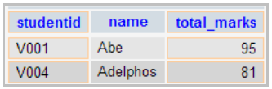
Example

Slide 8
Operator
IN
ALL, ANY (SOME)
EXISTS
Note:
  = SOME, = ANY similar IN operator
  != SOME, != ANY similar NOT IN operator

Slide 9
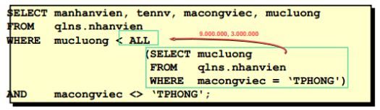
Example 2

Slide 10
View
A view can be considered as the logic of the table whose content is determined from a query
View does not save data directly in Database
  When changing data of tables related to View, after that accessing to View, data will be up to date
View should only be used for Selecting and should not be used for Updating, Inserting, Deleting Record
Actually, the Update, Insert, Delete Record statement is called to the original table and update on it
Notes:
https://gokhanatil.com/2010/10/minus-and-intersect-in-mysql.html

Slide 11
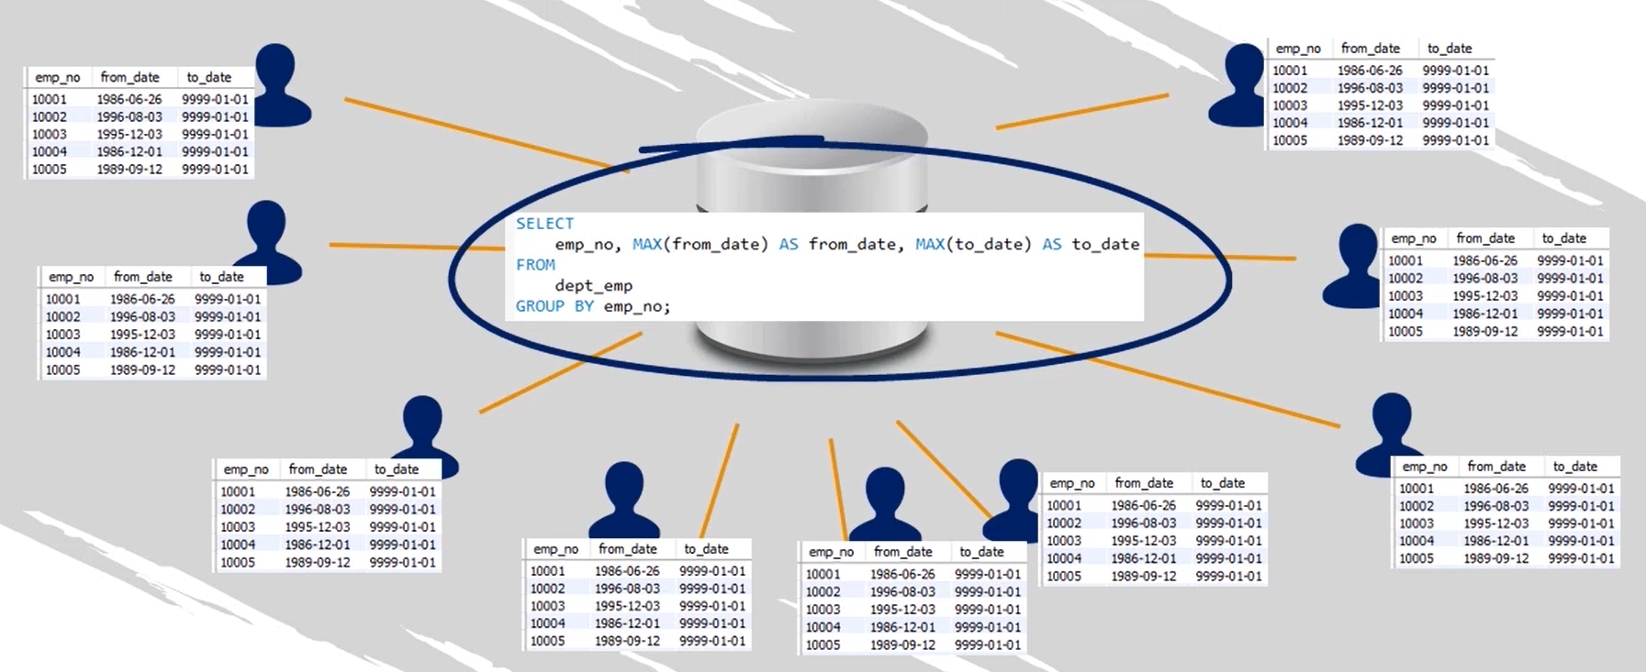
View
Notes:
https://gokhanatil.com/2010/10/minus-and-intersect-in-mysql.html

Slide 12


Syntax
Create View
Select data
Drop View
Notes:
https://gokhanatil.com/2010/10/minus-and-intersect-in-mysql.html

Slide 13
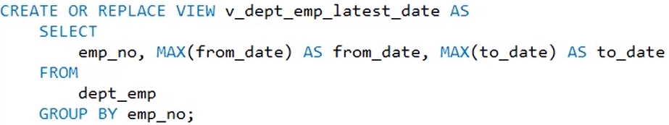
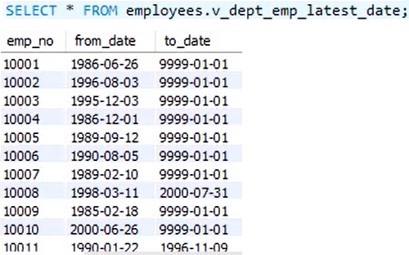
Example
Notes:
https://gokhanatil.com/2010/10/minus-and-intersect-in-mysql.html

Slide 14
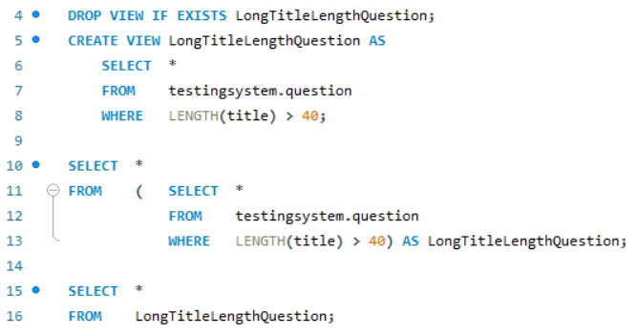
Example 2
Notes:
https://gokhanatil.com/2010/10/minus-and-intersect-in-mysql.html

Slide 15
CTE (Common Table Expression)
Simplify complex query which has multiple Join, Subquery
CTE be considered temporary table
Using for Recursive Queries
Replacing View, Temporary
Notes:
https://gokhanatil.com/2010/10/minus-and-intersect-in-mysql.html

Slide 16
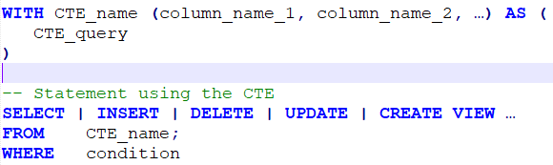
Syntax
Notes:
https://gokhanatil.com/2010/10/minus-and-intersect-in-mysql.html

Slide 17
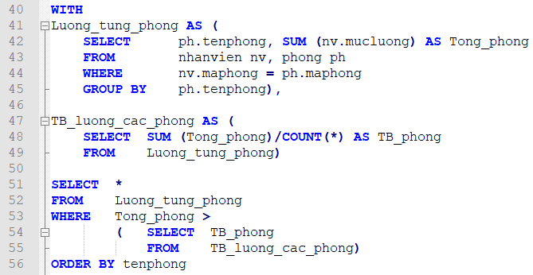
Example
Notes:
https://gokhanatil.com/2010/10/minus-and-intersect-in-mysql.html

Slide 18
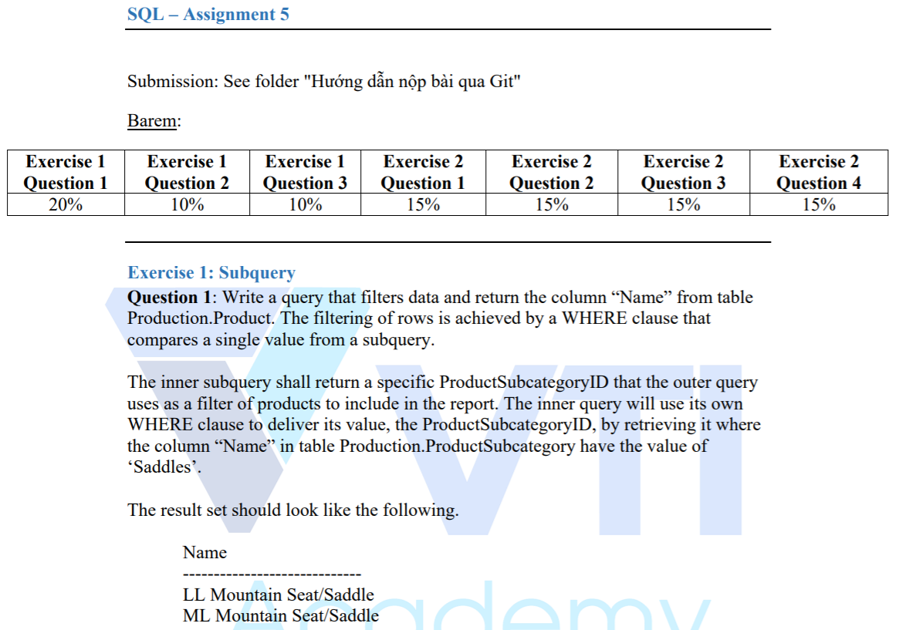
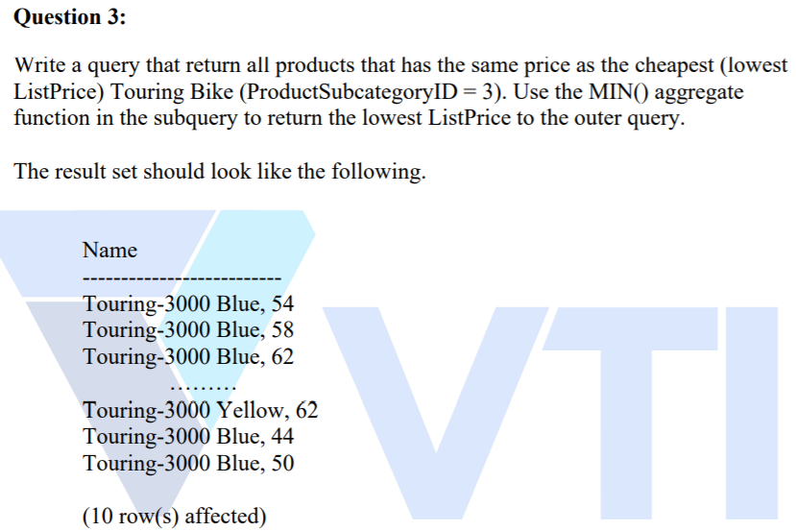
Assignments 1

Slide 19
Assignments 2
Assignments for Testing System

Slide 20
Q & A
Copyright © VTI Academy All Rights Reserved

